Slide 1
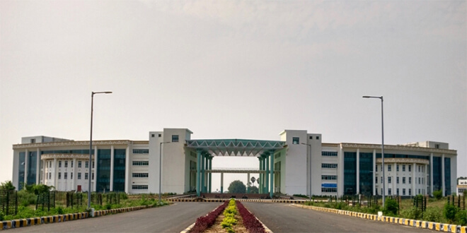

Virtualization
Dr. Rajiv Misra
Associate Professor
Dept. of Computer Science & Engg.
Indian Institute of Technology Patna
rajivm@iitp.ac.in
Cloud Computing and Distributed Systems
Virtualization

Slide 2
Preface
Content of this Lecture:
In this lecture, we will discuss virtualization technology its importance, benefits, different models and key approaches to virtualization in CPU, Memory and Device Virtualization.
Cloud Computing and Distributed Systems
Virtualization

Slide 3
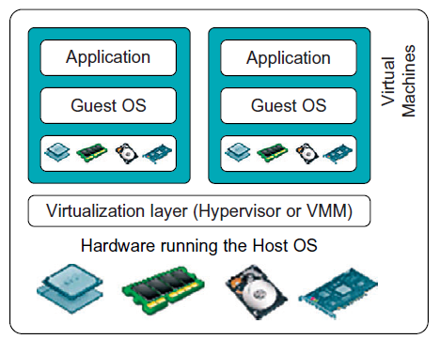
What is Virtualization ?
Virtualization is originated in the 1960s at IBM.
Virtualization allows concurrent execution of multiple OSs (and their applications) on the same physical machine.
Virtual resources = each OS thinks that it “owns” hardware resources
Virtual machine (VM) = OS+ applications + virtual resources (guest domain)
Virtualization layer = management of physical hardware (virtual machine monitor, hypervisor)
Cloud Computing and Distributed Systems
Virtualization

Slide 4
Defining Virtualization
A virtual machine is an efficient, isolated duplicate of the real machine.
Supported by a virtual machine monitor (VMM):
Provides environment essentially identical with the original machine
Programs show at worst only minor decrease in speed.
VMM is in complete control of system resources. (This means that the virtual machine monitor has full control to make decisions, who accesses which resources and when)
VMM Goals: Fidelity
Performance
Safety & isolation
Cloud Computing and Distributed Systems
Virtualization

Slide 5
Benefits of Virtualization
Consolidation: It is this ability to run multiple virtual machines, with their operating systems and applications on a single physical platform.
- Decrease cost, improve manageability (with fewer admins and with fewer electrical bills)
Migration: Migrate the OS in the applications from one physical machine to another physical machine.
- Greater availability of the services, improve reliability
Security: As the OS and the applications are nicely encapsulated in a virtual machine. It becomes more easy to contain any kinds of bugs, or any kinds of malicious behavior, to those resources that are available to the virtual machine only, and not to potentially affect the entire hardware system.
Some other benefits: Debugging, Provide affordable Support for legacy OSs
Cloud Computing and Distributed Systems
Virtualization

Slide 6
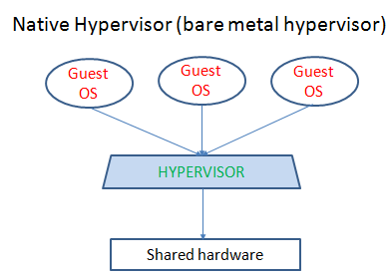
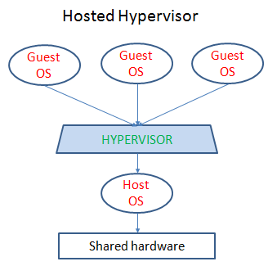
Virtualization Models
The two popular models for virtualization are called:
1. Bare-metal hypervisor
or Native Hypervisor (Type 1)
2. Hosted Hypervisor (Type 2)
Cloud Computing and Distributed Systems
Virtualization

Slide 7
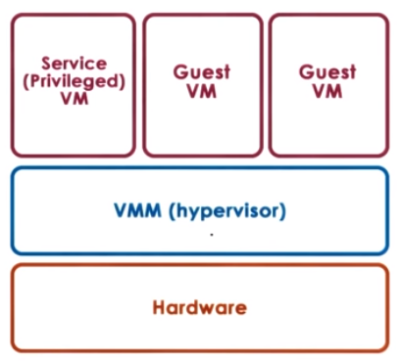
Bare-metal virtualization model
Bare-metal hypervisor (Type 1)
VMM (hypervisor) manages all hardware resources and supports execution of entire VMs.
Privileged, service VM to deal with devices (and other configuration and management task)
Cloud Computing and Distributed Systems
Virtualization

Slide 8
Bare-metal virtualization model
This model is adapted by the Xen virtualization solution (open source or Citrix Xen Server) and also by the VMware's hypervisor, the ESX hypervisor.
(i) Xen (Open source or Citrix Xen Server)
- The VMs that are run in the virtualized environment are referred to as domains.
- The privileged domain is called dom 0, and the guest VMs are referred to as domUs.
- Xen is the actual hypervisor and all of the drivers are running in the privileged domain, in dom 0.
(ii) ESX (VMware)
-Given that VMware and its hypervisors were first to market, VMware still owns the largest percentage of virtualized server cores. So these server cores run the ESX hypervisor and also provide the drivers for the different devices. That are going to be part of the hypervisor. To support a third party community of developers VMware exports a number of APIs.
Cloud Computing and Distributed Systems
Virtualization

Slide 9
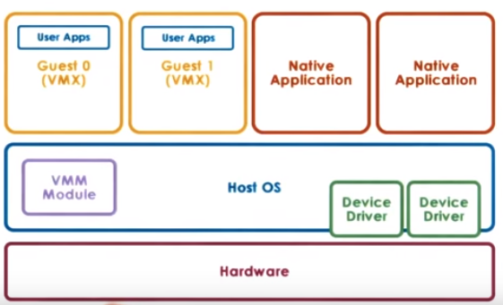
Hosted virtualization model
Hosted Hypervisor (Type 2)
In this model, at the lowest level, there is a full fledged host OS that manages all of the hardware resources.
The Host OS integrates a VMM module, that's responsible for providing the virtual machines with their virtual platform interface and for managing all of the context switching scheduling, etc.
Cloud Computing and Distributed Systems
Virtualization

Slide 10
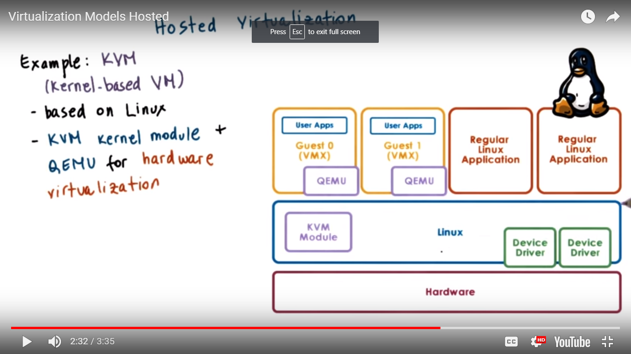
Hosted virtualization model
Example:
KVM (Kernel-based VM)
Based on Linux
KVM kernel module + hardware emulator called QEMU for hardware virtualization
Leverages large Linux open-source community
Cloud Computing and Distributed Systems
Virtualization

Slide 11
Hardware Protection Levels
Commodity hardware actually has more than two protection levels.
E.g. x86 architecture has four protection levels called rings.
Ring 3: In contrast, ring 3 has the least level of privilege, so this is where the applications would reside.
Ring 0: has the highest privilege and can access all of the resources and execute all hardware-supported instructions.
Cloud Computing and Distributed Systems
Virtualization

Slide 12
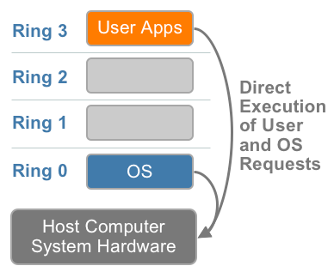
x86 Hardware without Virtualization
The x86 architecture offers four levels of privilege known as Ring 0, 1, 2 and 3 to operating systems and applications to manage access to the computer hardware. While user level applications typically run in Ring 3, the operating system needs to have direct access to the memory and hardware and must execute its privileged instructions in Ring 0.
Fig - x86 privilege level architecture without virtualization
Cloud Computing and Distributed Systems
Virtualization
Notes:
Virtualizing the x86
architecture requires placing a virtualization layer under
the operating system (which expects to be in the
most privileged Ring 0) to create and manage the
virtual machines that deliver shared resources.
Further complicating the situation, some sensitive
instructions can’t effectively be virtualized as they have different semantics when they are not
executed in Ring 0. The difficulty in trapping and translating these sensitive and privileged
instruction requests at runtime was the challenge that originally made x86 architecture
virtualization look impossible.

Slide 13
Processor Virtualization (Trap-and-Emulate)
Guest instructions
-executed directly by hardware
-for non-privileged operations: hardware speeds=> efficiency
-for privileged operations: trap to hypervisor
Hypervisor determines what needs to be done:
If illegal operation: terminate VM
If legal operation: emulate the behavior the guest OS was expecting from the hardware
Cloud Computing and Distributed Systems
Virtualization

Slide 14
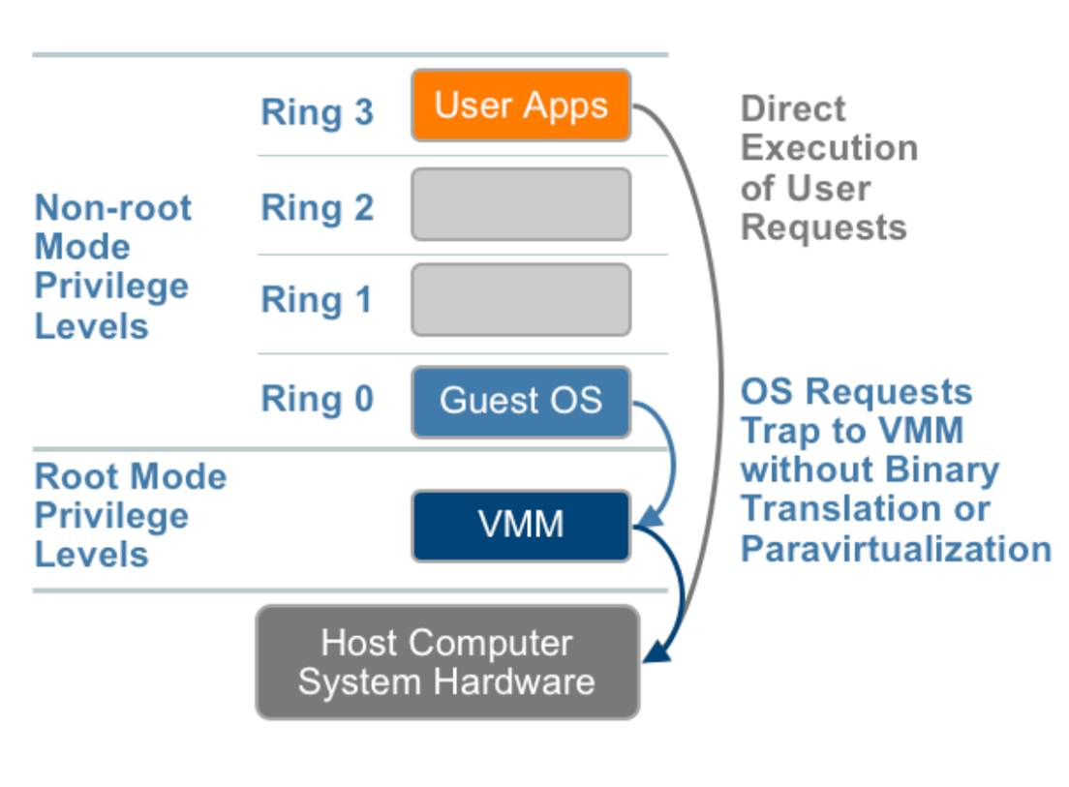
Problems with Trap-and-Emulate
X85 Pre 2005
-4 rings, no root/non-root modes yet
-hypervisor in ring 0, guest OS in ring 1
BUT: 17 privileged instructions do not trap! Fail silently!
E.g. interrupt enable/disable bit in privileged register; POPF/PUSHF instructions that access it from ring 1 fail silently
Hypervisor doesn’t know, so it doesn’t try to change settings
OS doesn’t know, so assumes change was successful/
Cloud Computing and Distributed Systems
Virtualization

Slide 15
Binary Translation
Main idea: rewrite the VM binary to never issue those 17 instructions
Pioneered by Mendel Rosenblum’s group at Stanford, commercialized as Vmware
Rosenblum awarded ACM Fellow for “reinventing virtualization”
Cloud Computing and Distributed Systems
Virtualization

Slide 16
Binary Translation
Binary translation:
Goal: full virtualization=guest OS not modified
Approach: dynamic binary translation
1. Inspect code blocks to be executed
2. If needed, translate to alternate instruction sequence
-e.g., to emulate desired behavior, possibly even avoiding trap
3. Otherwise, run at hardware speeds
-Cache translated blocks to amortize translation costs
Fig.: Binary translation approach to x86 virtualization
Cloud Computing and Distributed Systems
Virtualization

Slide 17
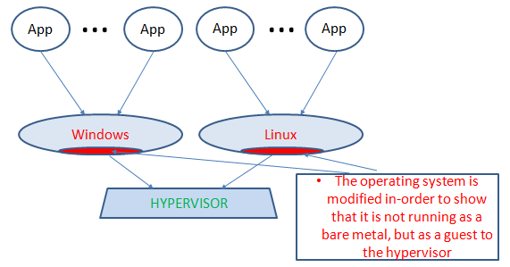
Para virtualization
Goal: performance; give up on unmodified guests
Approach: Para virtualization =modify guest so that
It knows it’s running virtualized
It makes explicit calls to the hypervisor (hypercalls)
Hypercall (~system calls)
- Package context info
- Specify desired hypercall
- Trap to VMM
- e.g. Xen= open source hypervisor (XenSource -> Citrix)
Cloud Computing and Distributed Systems
Virtualization

Slide 18
Para virtualization: Review !
What percentage of Guest OS code may need modification with para Virtualization?
10 %
50%
30%
2%
Answer: less than 2%.
This can be shown by a proof-of-construction by XEN
Xen is a para virtualized hypervisor.
Cloud Computing and Distributed Systems
Virtualization

Slide 19
Memory Virtualization
To run multiple virtual machines on a single system, one has to virtualize the MMU(memory management unit) to support the guest OS.
The VMM is responsible for mapping guest physical memory to the actual machine memory, and it uses shadow page tables to accelerate the mappings.
The VMM uses TLB (translation lookaside buffer) hardware to map the virtual memory directly to the machine memory to avoid the two levels of translation on every access.
Cloud Computing and Distributed Systems
Virtualization

Slide 20
Shadow Page table
VA- Virtual Address
PA- Physical Address
hit
VA
TLB
PA
miss
PT
CPU uses PT for address translation
Hardware PT is really the S PT(shadow Page Table)
Cloud Computing and Distributed Systems
Virtualization

Slide 21
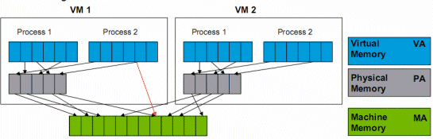
Memory Virtualization
Full virtualization
-all guests expect contiguous physical memory, starting at 0
-virtual vs. physical vs. machine addresses and page frame numbers
-Still leverages hardware MMU, TLB
Option 1:
-Guest page table: VM => PA
-Hypervisor: PA=> MA
-Too expensive
Option 2:
-Guest page table: VA => PA
-Hypervisor shadow Page Table: VA=> MA
-Hypervisor maintains consistence
e.g. invalidate on ctx switch, write-protect guest PT to track new mappings
Cloud Computing and Distributed Systems
Virtualization

Slide 22
Memory Virtualization
Para virtualization
-Guest aware of virtualization
-No longer strict requirement on contiguous physical memory starting at 0
-Explicitly registers page tables with hypervisor
-Can “batch” page table updates to reduce VM exists
-Other optimizations
Overheads eliminated or reduced on newer platforms
P2
P1
Guest OS
{
Create PT
Switch PT
Update PT
Hypercalls
HYPERVISOR
Cloud Computing and Distributed Systems
Virtualization

Slide 23
Device Virtualization
For CPUs and memory
Less diversity, ISA (instruction set architectures)level standardization of interface
For devices
High diversity
Lack of standard specification of device interface and behavior
Three Key models for device virtualization
(i) Passthrough Model
(ii) Hypervisor Direct Model
(iii) Split Device Driver Model
Cloud Computing and Distributed Systems
Virtualization

Slide 24
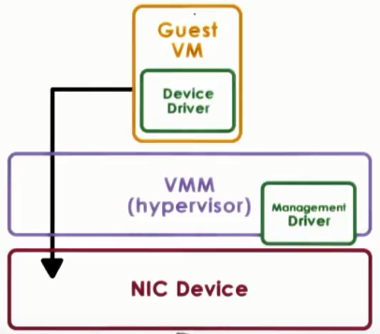
(i) Passthrough Model
Approach: VMM-level driver configures device access permissions
VM provided with exclusive access to the device
VM can directly access the device (also called VMM-bypass model)
Device sharing will become difficult.
VMM must have exact type of device as what VM expects
VM migration is tricky
Cloud Computing and Distributed Systems
Virtualization

Slide 25
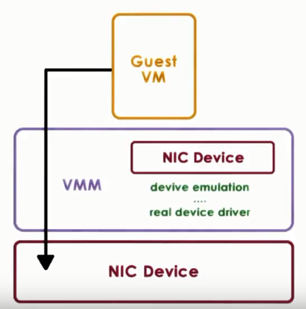
(ii) Hypervisor-Direct Model
Approach:
VMM intercepts all device accesses
Emulate device operation:
- translate to generic I/O operation
- traverse VMM-resident I/O stack
- invoke VMM-resident driver
Key benefits:
VM decoupled from physical device
Sharing, migration, dealing with device specifies
Downside of the model
Latency of device operations
Device driver ecosystem complexities in hypervisor
Cloud Computing and Distributed Systems
Virtualization

Slide 26
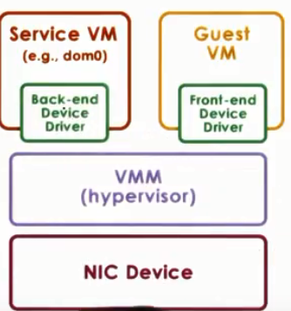
(iii) Split-Device Driver Model
Approach:
Device access control split between
-Front end driver in guest VM (device API)
-Back-end driver in service VM (or host)
Modified guest drivers
i.e. Limited to para virtualized guests
Eliminate emulation overhead allow for better management of shared devices
Cloud Computing and Distributed Systems
Virtualization

Slide 27
Conclusion
In this lecture, we have defined virtualization and discussed the main virtualization approaches.
We have also described processor virtualization, memory virtualization and device virtualization used in virtualization solutions, such as Xen, KVM and the VMware .
Cloud Computing and Distributed Systems
Virtualization

